Slide 1
Dark Patterns

Slide 2
Tricks of the Trade?
In general, dark patterns are used to:
Manipulate the user
Force the user into doing things he/she doesn’t want

Slide 3
A Definition
A dark pattern is a type of user interface that appears to have been carefully crafted to trick users into doing things that are not in their interest and is usually at their expense.
Harry Brignull, UX designer

Slide 4
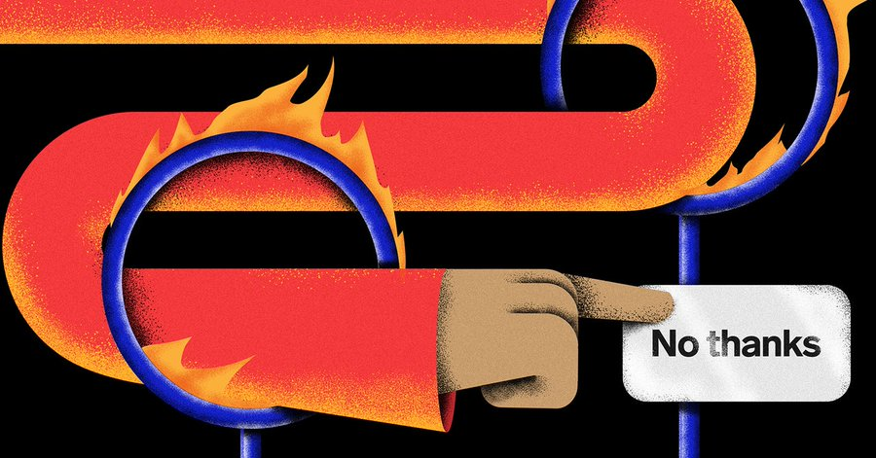
Or as some Wired author wrote….
When Instagram repeatedly nags you to “please turn on notifications,” and doesn’t present an option to decline? That’s a dark pattern. When LinkedIn shows you part of an InMail message but forces you to visit the platform to read more? Also a dark pattern.

Slide 5
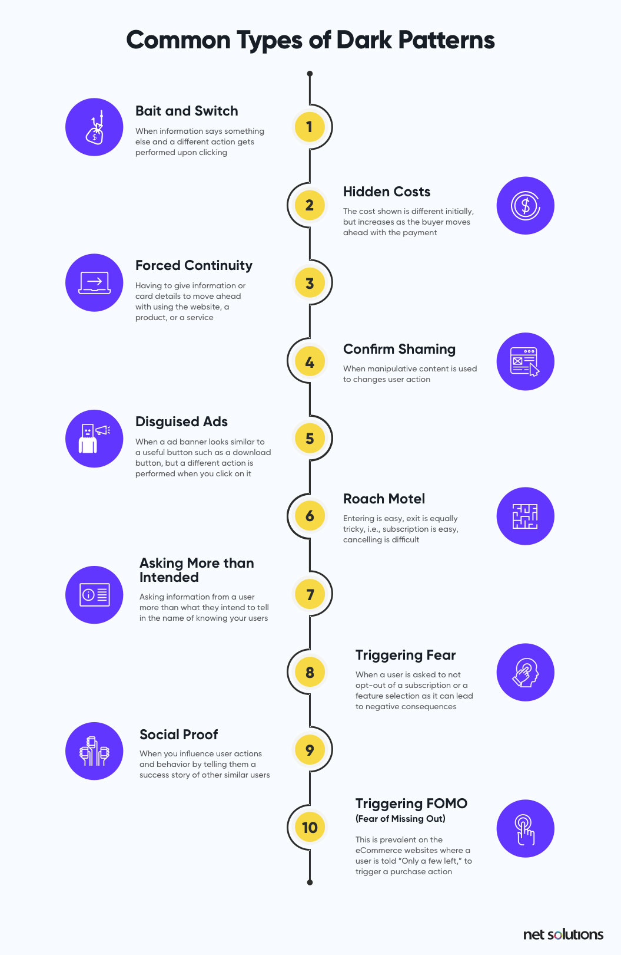

Slide 7
Let’s pick out one or two….
Example 1: Hidden Costs
When a specific price is displayed for a product or a service, and the price shockingly increases (taxes and delivery fees) once the user moves ahead with the checkout.

Slide 8
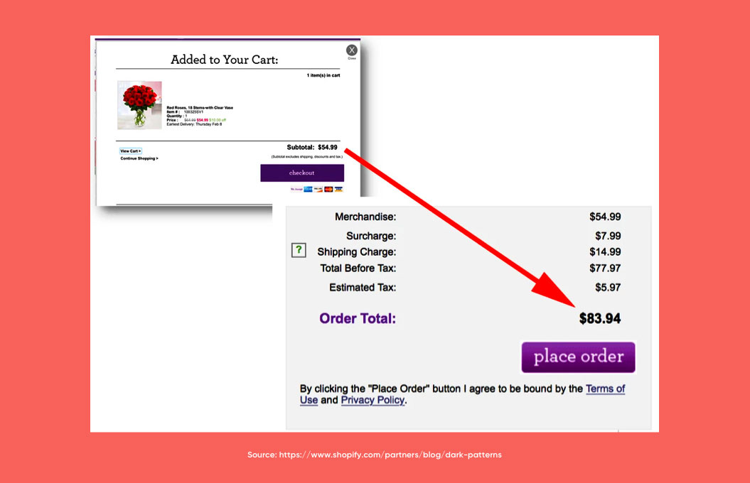
Hidden Costs

Slide 9
Disguised Ads
A disguised ad is a dark pattern where an advertisement banner on the website or the app looks similar to useful content that the user is looking for and falsely clicks on to realize later that they have been spammed.
Forty percent of users click on an ad because it seems interesting, while a whopping 34 percent click on an ad by mistake, often tricked into clicking them. (Hubspot)

Slide 10
There are more…
Roach Motel - You can get in easily, but you can’t check out.
  For example, subscribing is easy, but when it comes to canceling the subscription — the option is neither findable nor discoverable.
Triggerin FOMO (fear of missing out)
  This is more prevalent on the eCommerce websites where a user is told “Only a few left” to trigger a purchase action. This is done by almost every eCommerce business today to increase order volumes.

Slide 11
Reasons to avoid Dark Patterns….
Any ideas why?

Slide 12
Sources
I got all this good info from these websites:
https://www.netsolutions.com/insights/dark-patterns-in-ux-disadvantages/
https://en.wikipedia.org/wiki/Dark_pattern

